Slide 1
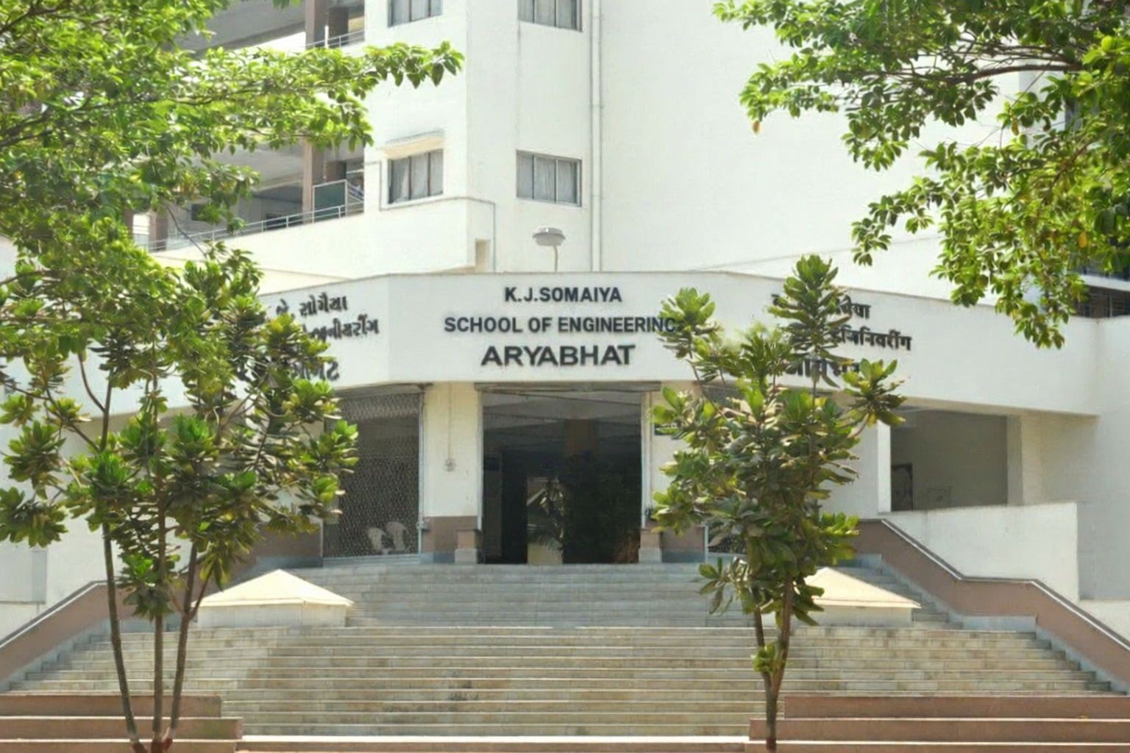
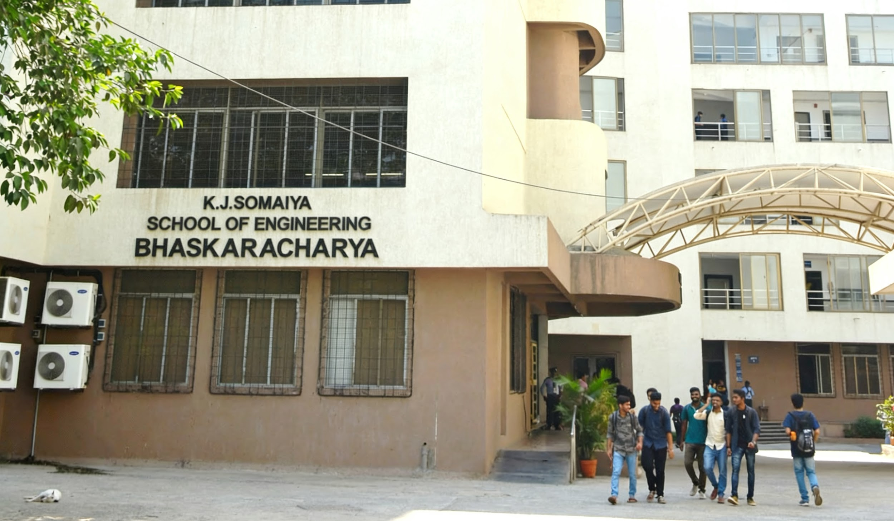
Object Oriented Programming
Module 1

Slide 2
Contents
Introduction
Basic program construction
Procedural Programming Approach
Structured Programming Approach
Modular Programming Approach
OOP Approach

Slide 3
Why Move from C to JAVA
🔹 Growth of Software Systems
🧩 Software evolved from small programs to large, complex, distributed systems
🔹 Limitations of C
⚙️ Procedure-centric → logic scattered across functions 🧠 Manual memory management → errors, leaks, crashes 🔓 Low data security → no access control 📉 Poor scalability for large teams and long-term projects
🔹 Why Java?
🧱 Object-Oriented (OOP) → real-world modelling using objects 🗑️ Automatic memory management (Garbage Collection) 🌍 Platform independent (Write Once, Run Anywhere) 🔐 Secure and robust by design

Slide 4
Programming Approaches
🔹 Procedural Programming
⚙️ Function-centric ➡ Focus on how tasks are performed 📌 Example: C
🔹 Structured Programming
🔁 Sequence • Selection • Iteration 🚫 Avoids goto 📖 Improves readability
🔹 Modular Programming
🧩 Program split into modules 🔄 Reusable & maintainable code 🛠 Each module → one responsibility
🔹 Object-Oriented Programming
🧱 Objects = Data + Methods 🌍 Models real-world entities 📌 Example: Java
Programming evolved to manage increasing software complexity

Slide 5
Introduction
Object-Oriented Programming (OOP)
is a programming paradigm that organizes software design around objects, which represent real-world entities.
An object combines data (attributes) and behavior (methods)
Objects interact with each other to perform tasks
OOP helps manage software complexity, reusability, and maintainability
Examples: C++, JAVA, Python
Key Idea: Model the real-world using objects that encapsulate state and behavior
OOP emphasizes modularity, abstraction, and reusability in software development

Slide 6
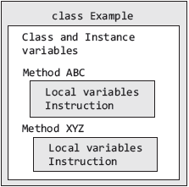
Basic Program Structure
A Java Application consists of a collection of classes
A class is a template containing methods and variables

Slide 7
First Java Program
/* Call this file “Example.java”.*/
class Example {
//your program starts execution with a call to //main()
public static void main(String args[ ]){
System.out.println(“This is a simple Java program”);
}
}

Slide 8
Procedural Programming Approach
Specifying the steps the program must take to reach the desired state
Based upon the concept of the procedure call
Procedures:
Routines, subroutines, methods, or functions that contain a series of computational steps to be carried out
Any given procedure might be called at any point during a program's execution, including by other procedures or itself
Using a procedural language, the programmer specifies language statements to perform a sequence of algorithmic steps

Slide 9
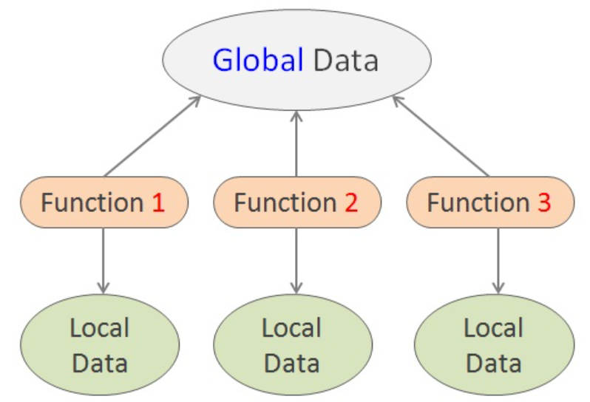
Procedural Programming Approach
Complexity increases as the length of a program increases .
Divide a large program into different functions or modules
Problems with Procedural languages
functions have unrestricted access to global data
that they provide poor mapping to real world
Procedural languages are not extensible
Example: Fortran, C, Pascal

Slide 10
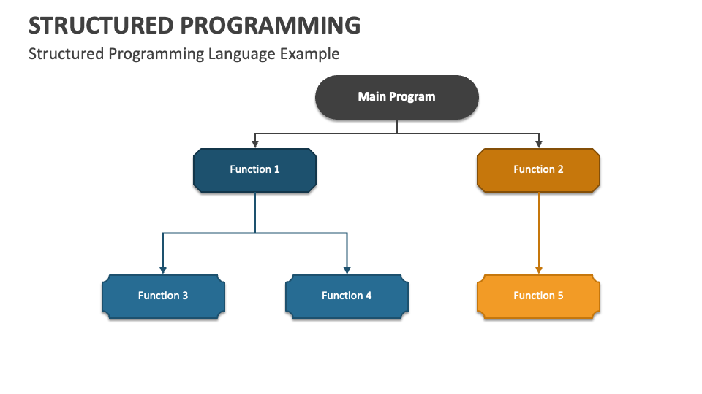
Structured Programming Approach
A technique for organizing and coding programs in which hierarchy of modules is used
Each module has a single entry and single exit point
Control is passed downward through the structure without unconditional branches to higher levels
Three types of control flow: Sequential, Test or Selection, Iteration

Slide 11
Structured Programming Approach
Sequence
// Sequence of statements in C
int x = 5;
int y = 10;
int sum = x + y;
printf("The sum is: %d\n", sum);

Slide 12
Structured Programming Approach
Sequence
// Sequence of statements in JAVA
int x = 5;
int y = 10;
int sum = x + y;
System.out.println("The sum is: " + sum);

Slide 13
Structured Programming Approach
Selection
// if-else statement in C: Selection (Condition)
int number = 10;
if (number > 0)
{
printf("The number is positive.\n");
} else {
printf("The number is negative or zero.\n");
}

Slide 14
Structured Programming Approach
Selection
// if-else statement in JAVA: Selection (Condition)
int number = 10;
if (number > 0)
{
System.out.println("The number is positive.\n");
} else {
System.out.println("The number is negative or zero.\n");
}

Slide 15
Structured Programming Approach
Iteration
// for loop in C
for (int i = 0; i < 5; i++) {
printf("Iteration: %d\n", i);
}
// while loop in C
int count = 0;
while (count < 5) {
printf("Count: %d\n", count);
count++;
}
// do-while loop in C
int num = 0;
do {
printf("Number: %d\n", num);
num++;
} while (num < 5);

Slide 16
Structured Programming Approach
Iteration
// for loop in JAVA
for (int i = 0; i < 5; i++) {
System.out.println("Iteration: " + i);
}
// while loop in JAVA
int count = 0;
while (count < 5) {
System.out.println("Count: " + count);
count++;
}
// do-while loop in JAVA
int num = 0;
do {
System.out.println("Number: " + num);
num++;
} while (num < 5);

Slide 17
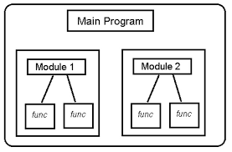
Modular Programming Approach
A technique for separating functionality into independent, interchangeable modules
Each module contains everything necessary to execute only one aspect
Sub-programs or functions

Slide 18
Modular Programming Approach
// Main.java (Main Module)
public class Main {
public static void main(String[] args) {
// Call the method from another module
int result = Calculator.add(5, 10);
System.out.println("The sum is: " + result);
}
}
// Calculator.java (Calculator Module)
public class Calculator {
public static int add(int a, int b) {
return a + b;
}
}

Slide 19
Structure of Complex Systems
Examples:
Structure of a Personal Computer: Complexity - Moderate
Composed of: a central processing unit (CPU), a monitor, a keyboard, and secondary storage device
CPU typically encompasses primary memory, an arithmetic/logic unit (ALU), and a bus to which peripheral devices are attached
An ALU may be divided into registers and random control logic, which themselves are constructed from even more primitive elements, such as NAND gates, inverters

Slide 20
Structure of Complex Systems
Examples:
Structure of a Plants and Animals
Plants consist of three major structures (roots, stems, and leaves), and each of these has its own structure.
Animals exhibit a hierarchical structure : collections of cells form tissues, tissues work together as organs, clusters of organs define systems (such as the digestive system)

Slide 21
Inherent Complexity of Software
The inherent complexity derives from four elements. They are
The complexity of the problem domain.
The difficulty of managing the developmental process.
The flexibility possible through software
The problems of characterizing the behavior of discrete systems.

Slide 22
Attributes of Complex Systems
Hierarchical Structure
Complex systems are organized into multiple levels.
Each level is composed of subsystems, which themselves may contain smaller subsystems.
Higher levels abstract the details of lower levels.
Example: Software → Modules → Classes → Functions
Modularity
The system is divided into well-defined modules.
Each module performs a specific function.
Improves understandability, maintainability, and reuse.
Example: Authentication, database, UI as separate modules.

Slide 23
Attributes of Complex Systems
Interdependency
Components of the system depend on one another.
A change in one component can affect others.
Managing dependencies is a major challenge in complex systems.
Example: Changing a database schema affects business logic and UI.
Emergent Behavior
The overall system behavior cannot be predicted by examining individual components alone.
Behavior emerges due to interactions among components.
Example: System performance issues arising only under real-world load.

Slide 24
Attributes of Complex Systems
Evolution over time
Complex systems are never static.
They evolve due to new requirements, fixes, and environmental changes.
Continuous change increases complexity.
Example: Software updates, feature additions, scalability requirements.

Slide 25
Thank You

